Slide 1

CELL BIOLOGY Lec ( 5 ) types of Cell Transport
1- Passive transport------Not require ATP
2- Active transport-------------require ATP

Slide 2

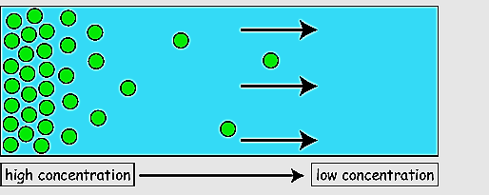
Types of cell transport
Passive transport
1– Diffusion: which is the movement of molecules down their concentration gradient without the use of energy.

Slide 3

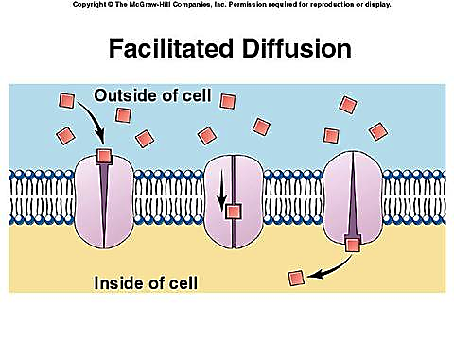
Types of cell transport
2- Facilitated diffusion: that is, the diffusion of particles across a selectively permeable membrane with the assistance of the membrane's transport proteins, this process does not require the input of energy.

Slide 4
Types of cell transport
3- Osmosis: which is the passive diffusion of water. Water moves from a region of high water concentration to a region of low water concentration. Thinking about osmosis another way, water will flow from a region with a lower solute concentration (hypotonic) to a region with a higher solute concentration (hypertonic).

Slide 5

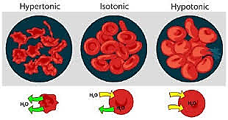
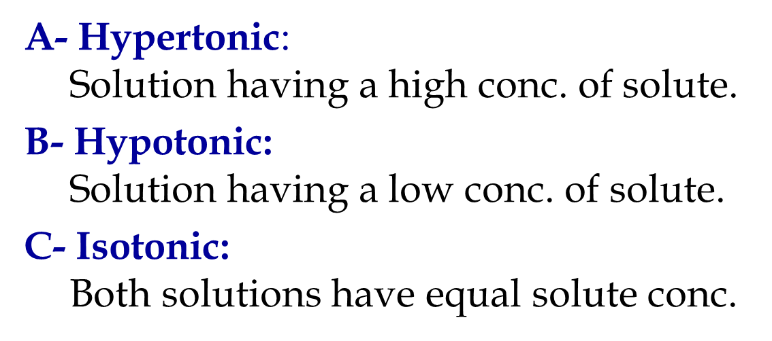

Slide 6
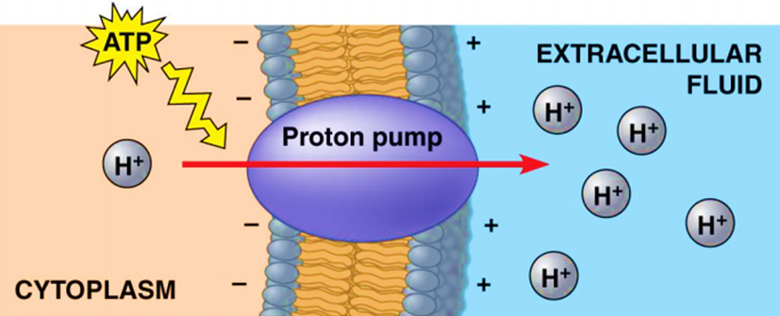
Types of cell transport
Active transport
• Uses energy to move molecules against their gradients.
• All carrier proteins.
• Includes ion pumps and endocytosis, exocytosis

Slide 7
Types of cell transport
Ion pumps: ex. Sodium-Potassium Pump
-The Sodium-Potassium Pump is a structure known as a cell-membrane pump that uses energy to transport Sodium and Potassium ions in and out of the cell. There are other varieties of cell membrane pump; however, the sodium-potassium pump plays a vital role in maintaining a cell's homeostasis.
-The pump is powered by a molecule of ATP. The ATP allows the shape of the pump to change, emptying its contents either into or out of the cell.

Slide 8

Types of cell transport
Below are the steps that the sodium-potassium pump uses to function:
1. Three sodium ions form inside the cell bind to the pump.
2. The Phosphate group form a molecule of ATP binds to the pump.
3. The pump changes shape and the sodium ions are released outside the cell.
4. Two potassium ions bind to the pump.
5. The phosphate group is released form the pump and the pump again changes shape and releases the ions into the inside of the cell.
----3 Na+ pumped out of the cell
----2 K+ pumped into the cell

Slide 9
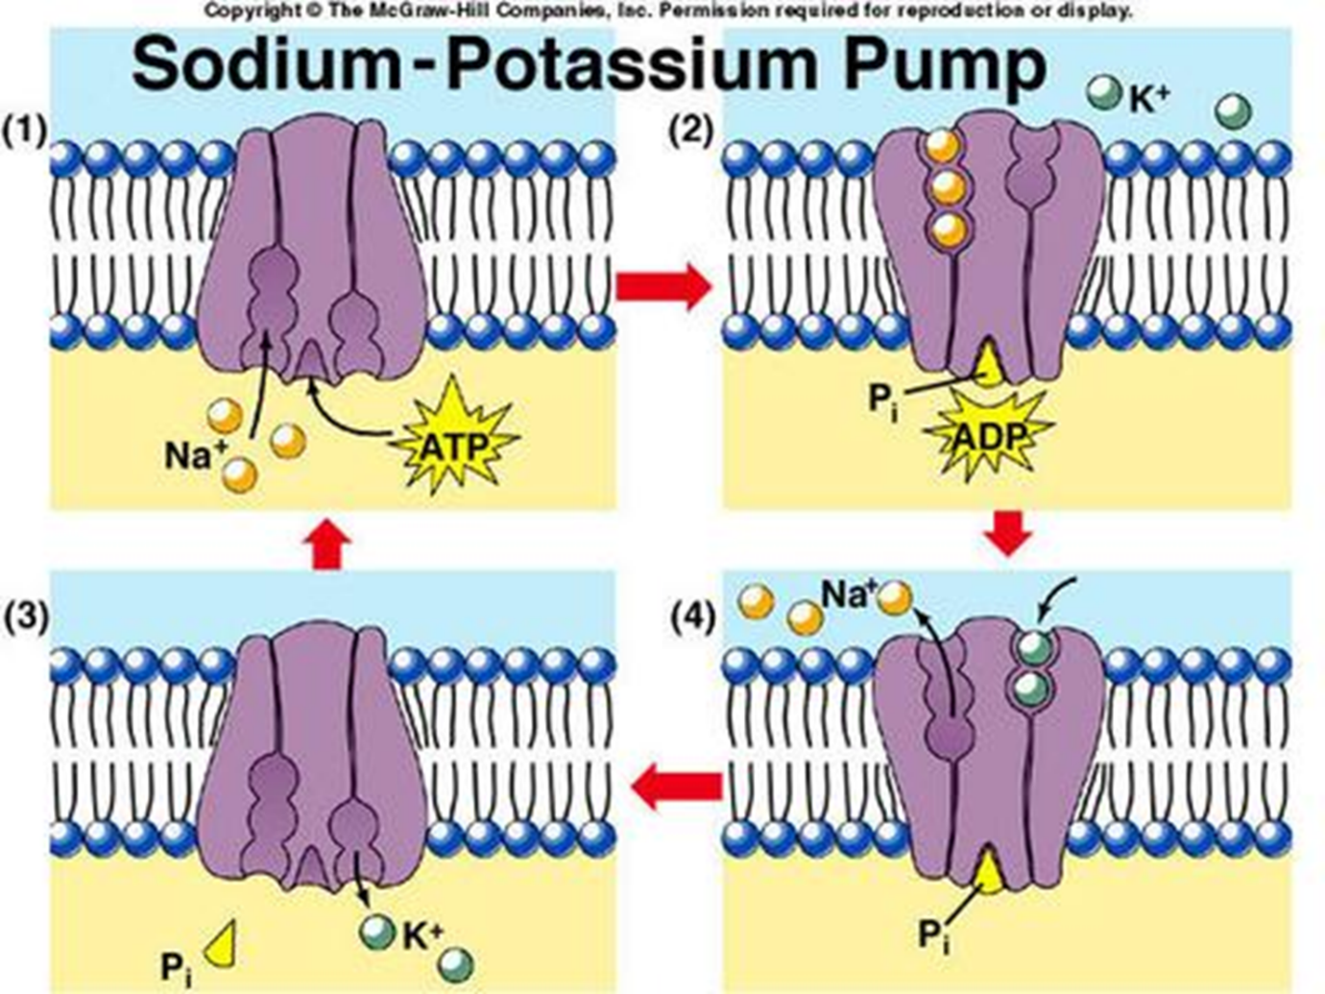

Slide 10
Exocytosis / endocytosis
The movement of macromolecules such as proteins or polysaccharides into or out of the cell is called bulk transport. There are two types of bulk transport, exocytosis and endocytosis, and both require energy (ATP).
----Exocytosis, materials are move out of the cell via secretory vesicles. In this process, the Golgi complex packages macromolecules into transport vesicles that travel to and fuse with the plasma membrane. This fusion causes the vesicle to spill its contents out of the cell.
----Exocytosis is important in removal of waste materials out of the cell and in the secretion of cellular products such as digestive enzymes or hormones.

Slide 11
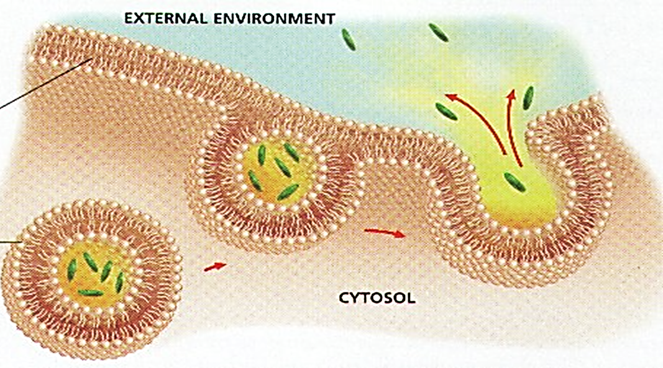

Slide 12
Exocytosis / endocytosis
Endocytosis, is the process by which materials move into the cell. There are three types of endocytosis:
phagocytosis or “cellular eating,” the cell’s plasma membrane surrounds food – buds off a vacuole. Lysosomes then secrete enzymes into vacuole to digest food.
pinocytosis or “cellular drinking,” smaller infolding of phagocytosis allows droplets of liquid to enter.

Slide 13
Exocytosis / endocytosis
receptor-mediated endocytosis in this highly specific process, the cell takes in only certain molecules, this specificity is mediated by receptor proteins located on the cell plasma membrane. Once bound, a vesicle formed, and fuses with a lysosome to digest the engulfed material and release it into the cytosol. Mammalian cells use receptor-mediated endocytosis to take cholesterol into cells. Cholesterol in the blood is usually found in lipid-protein complexes called low-density lipoproteins (LDL). LDL bind to specific receptor proteins on the cell surface..

Slide 14

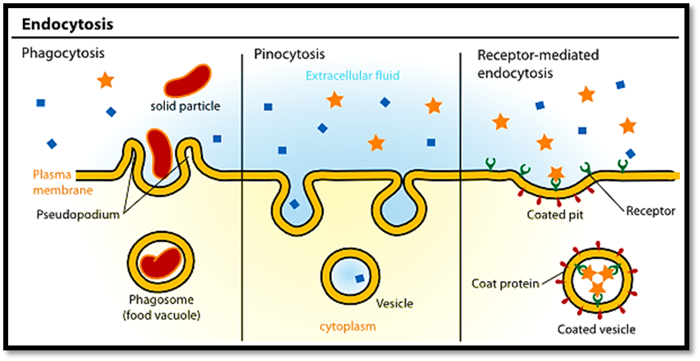

Slide 15

